Slide 1
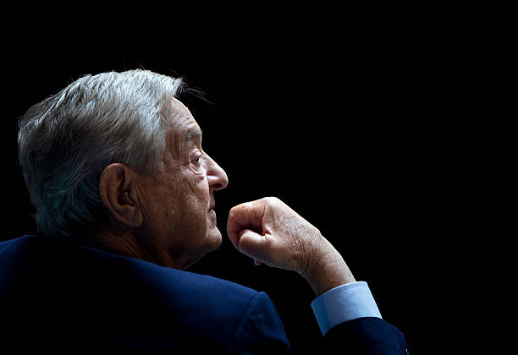
George Soros
The Man Who Broke the Bank of England
Author : The Alchemy of Finance

Slide 2
Strategy Development
Core Trading Philosophy: Soros' strategy is grounded in the concept of reflexivity—where markets don't just reflect fundamentals, they influence them. He believes that market participants' perceptions can drive prices far from reality, creating opportunities.
Principles:
Markets are inherently biased and tend to exaggerate trends.
Boom-bust cycles are created by self-reinforcing feedback loops where rising prices attract more buyers, and falling prices push more sellers.
Example:
1992 British Pound Short: Soros recognized the UK's inability to sustain the pound's peg within the European Exchange Rate Mechanism, leading to a $1 billion profit by shorting the currency.

Slide 3
Timing
How Soros Times His Trades:
Asymmetric Opportunities: He seeks situations where the potential upside significantly
outweighs the downside.
Catalyst-driven Approach: Soros positions himself ahead of major economic shifts or policy changes,
using macroeconomic analysis as a guide.
Indicators for Entry and Exit:
Market sentiment: He Gauges investor mood (overly optimistic or pessimistic).
Policy actions: Monitors central bank decisions, interest rates, and currency interventions.
Example:
Asian Financial Crisis (1997): Soros anticipated devaluations in overvalued currencies by analyzing economic indicators and unsustainable debt levels.

Slide 4
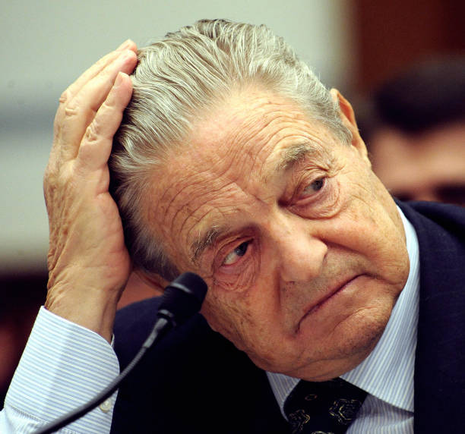
Dynamic Risk Approach:
Position Sizing: George adjusts the size of trades based on confidence. Increases exposure when signals
confirm his analysis, cuts losses early if evidence contradicts his view.
Stop-Loss Discipline: Willingness to quickly admit mistakes and reduce positions when markets move
against him.
Principle:
"It's not about being right all the time, but about making more when right than losing when wrong."
Example:
During the tech bubble of the late '90s, Soros took profits early, recognizing signs of a market peak, thus avoiding significant losses.
Risk Management

Slide 5
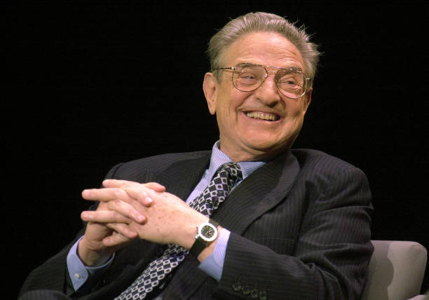
Flexible Strategy Adjustment:
Continuous Evaluation: Soros regularly re-evaluates market conditions and adapts his
strategy as new information emerges. He avoids rigid approaches.
Crisis as Opportunity: Views periods of high volatility as moments to capitalize on market dislocations.
Navigating Different Markets:
Bull Markets: Tends to take larger positions, leveraging momentum.
Bear Markets: Focuses on defensive plays and hedging against further downturns.
Example:
2008 Financial Crisis: Shifted focus from equities to safer assets like gold and short positions
in financials, exploiting the turmoil.
Adaptability

Slide 6
Emotional Awareness:
He accurately recognizes that markets are driven by emotions like fear and greed. Soros aims to understand the psychology behind market movements.
Mental Flexibility: He taught to keep an open mind, regularly challenges his own views, and is willing to change positions when conditions change.
Discipline:
Ruthless Self-Assessment: Soros constantly questions his assumptions, making adjustments to avoid complacency.
Staying Calm Under Pressure: He used adversity as a learning tool rather than panicking, helping him to maintain composure during market turbulence.
Quote:
"The market is a constantly shifting puzzle, and it pays to remain humble and adaptive."
Role of Psychology in Trading

